Slide 1
Advanced FrontEnd & Backend
Ing. Matías S. Iacono
MCPD – MCTS - CSM

Slide 2


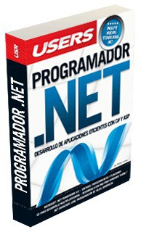


About me
Scrum Master & Program Manger
Book Publisher
jsGFwk
Open source framework for game development

Slide 3
Agenda
Desarrollo Web
Advanced JavaScript
OOP
Callers
Function pointers
Prototyping
Concepts of jQuery
Selectors
AJAX
Design Patterns
Optimizing the code
Generics
Reflection
COR, singleton, factories, and more
Code Improvement
Building testing code
Unit Test
PEX
TDD
Dependencies and code injection
Automation of code
Decorations
Abstractions
Auto generated code
N-Tier

Slide 4

The rules
Practice, practice & more practice.
Of course, more practice.

Slide 5
JavaScript
The beginning.

Slide 6

[JavaScript] Objects
Problem 1:
Create an object that exposes public and private functions.
Problem 2:
Create an destructible object.
Problem 3:
Makes copies of a JSON notation object.
Problem 4:
Object navigation.
Problem 5:
Encapsulate objects in Namespaces.

Slide 7

[JavaScript] Function Pointers
Problem 6:
Function injection.
Problem 7:
Switching.

Slide 8

[JavaScript] Callers
Problem 8:
Complex calls.

Slide 9

[JavaScript] Prototyping
Problem 9:
Extending objects.
Problem 10:
Inherit from another object.

Slide 10
JavaScript Sum Up
JavaScript is a fully OOP language.
It use prototypal approach to handle inheritance.
A type and an object can be easily extended.
Function pointers can be used to derive the code workflow.
Extra points:
Problem 11/12/13:
Patterns.

